Slide 1
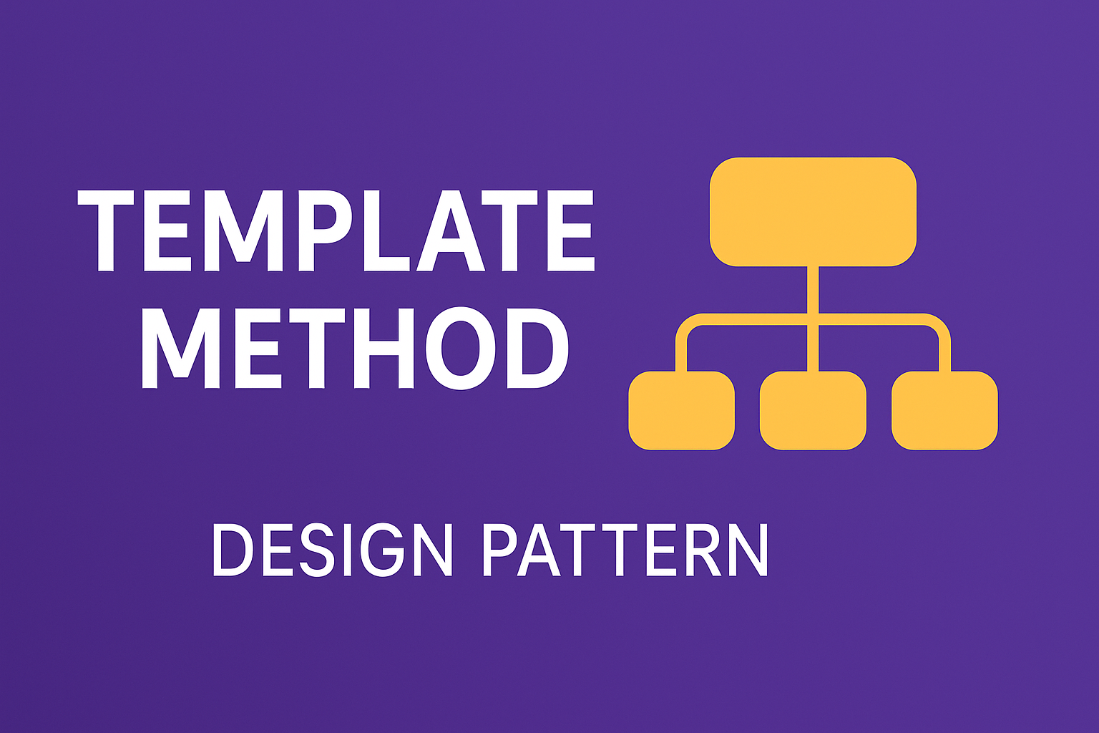
Template Method Design Pattern
A Behavioural Design Pattern

Slide 2
Creational (5)
Factory
Structural (7)
Adapter
Behavioral (11)
Chain Of Responsibility
Abstract Factory
Singleton
Prototype
Builder
Bridge
Composite
Decorator
Facade
Flyweight
Proxy
Command
Interpreter
Iterator
Mediator
Memento
Observer
State
Strategy
Template
Visitor

Slide 3
OOP Principals
Class
Object
Constructors
Inheritance
Method Overriding
Encapsulation
Interfaces
Abstractions
Polymorphism

Slide 4
Template Method Design Pattern
Behavioral patterns also focus on how independent objects work towards a common goal.
The template method defines an algorithm's steps deferring the implementation of some steps to subclasses.
It is a behavioral design pattern and is concerned with the assignment of responsibilities.
Template Method Pattern defines the skeleton of an algorithm in the superclass but allows subclasses to override specific steps of the algorithm without changing the structure.

Slide 5
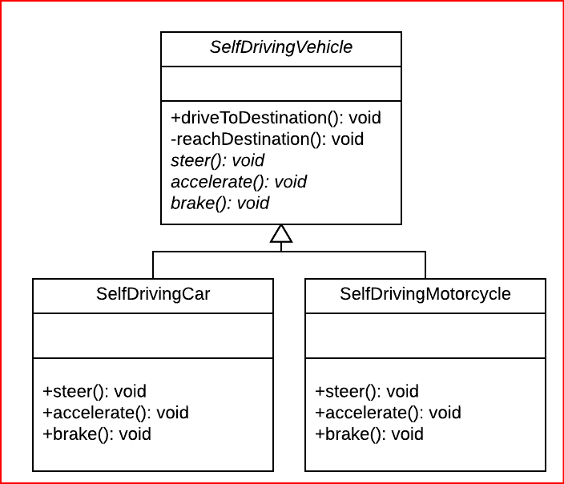

Slide 6
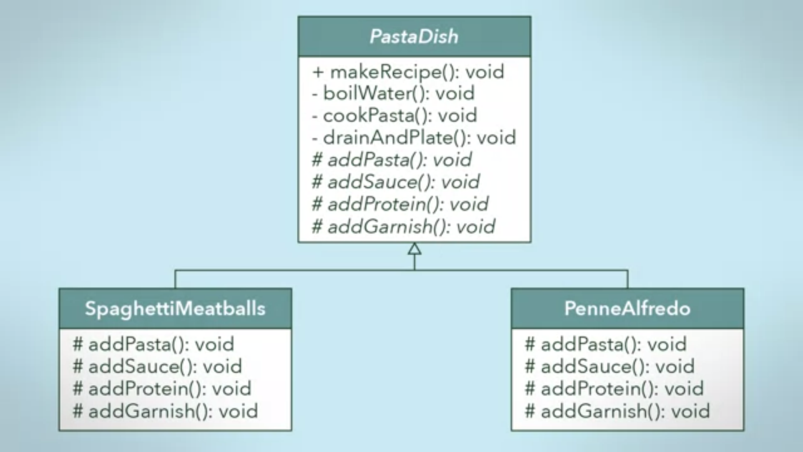

Slide 7
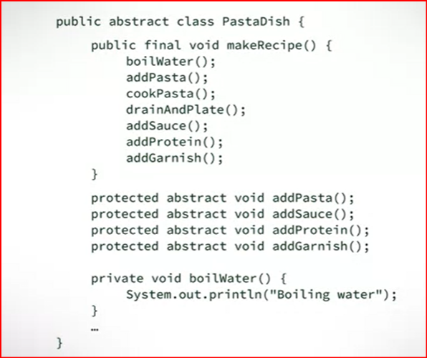

Slide 8
Recap: Interface vs Abstract
6
Aspect | Interface | Abstract Class
Purpose | Defines a contract (what a class must do). | Provides a base class with common behavior (what a class is).
Methods | Only method signatures (no implementation, except default/static methods in some languages). | Can have both abstract methods (no body) and concrete methods (with body).
Fields / Variables | Cannot have instance variables (only constants). | Can have instance variables and state.
Inheritance | A class can implement multiple interfaces. | A class can inherit only one abstract class.
Use Case | When different classes must follow the same rules but are otherwise unrelated. | When classes share a common base and behavior, but also need to enforce some methods.

Slide 9
Final - Cannot be overwritten at the sub classes.

Slide 10
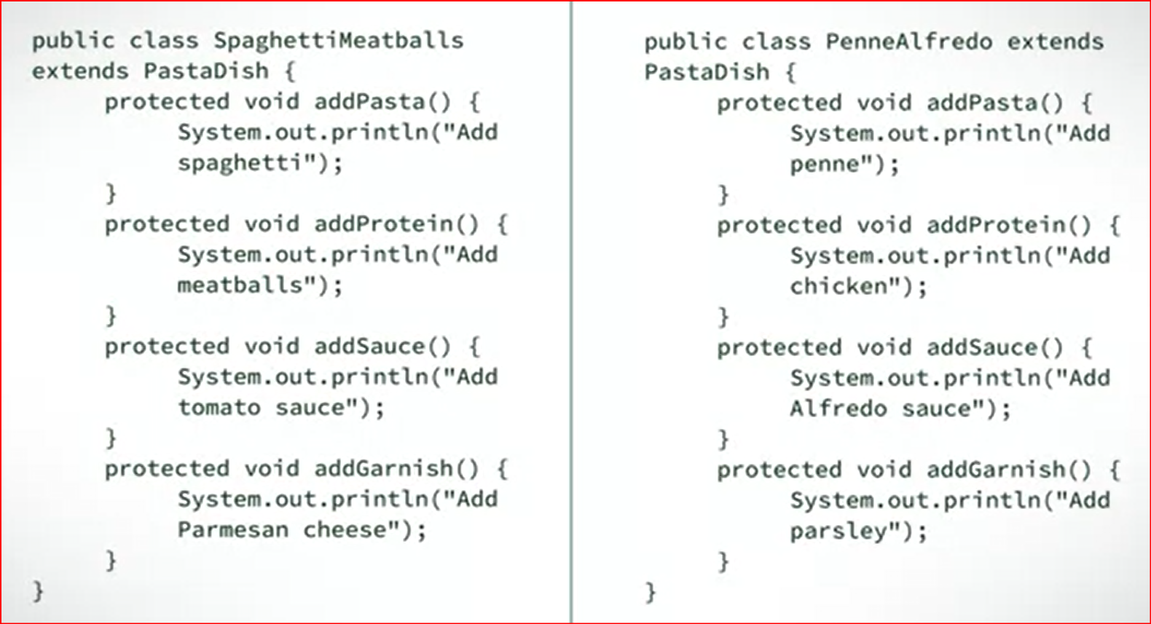

Slide 11
Usage
Multiple classes with same functional operations with different implementations and same order of executions.
Practical application of generalization and inheritance
Popular in framework development
Avoid code duplication
Code Reusability

Slide 12
In this pattern, subclasses can simply redefine the methods based on their needs

Slide 13
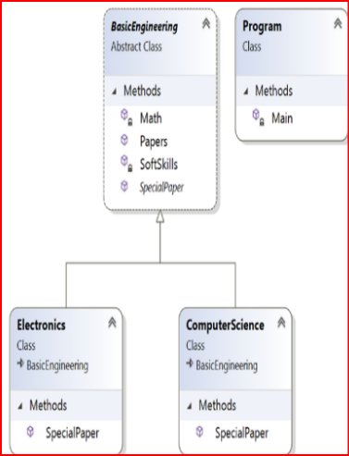
In the abstract class BasicEngineering, only one method is abstract (SpecialPaper), and the other two methods are concrete methods. What is the reason behind this?
Answer: This is a simple example with only three methods, and you want the subclasses to override only the SpecialPaper() method here. Other methods are common to both courses, and they do not need to be overridden by the subclasses

Slide 14
Advantages of using a Template Method Design Pattern
You can control the flow of the algorithms. Clients cannot change them.
Common operations will be in a centralized location. For example, in an abstract class, the subclasses can redefine only the varying parts so that you can avoid redundant code.

Slide 15
Challenges Associated with a Template Method Design Pattern
The client code cannot direct the sequence of steps. If you want that type of functionality, use the Builder pattern.
A subclass can override a method defined in the parent class (in other words, hiding the original definition in the parent class)
Having more subclasses means more scattered code, which is difficult to maintain.

Slide 16
Reflective Questions
How does the Template Method pattern balance reusability and customizability when defining an algorithm’s structure?
In what situations might using the Template Method lead to rigidity or overgeneralization, and how can this be avoided?
How does the Template Method pattern encourage code consistency across subclasses while still allowing subclass-specific behavior?

